Slide 1
Home insurance lapse predictor
Kyosuke Morita

Slide 2
Table of Contents
Data
Features
Modelling analysis
Evaluation of the model
Conclusion and Next steps

Slide 3
Data
Data was collected between 2007 and 2012
256,136 policies
Target variable
Missing values

Slide 4
Features
86 features were used in the final model
Most of them are dummy variables
Most important features are
Marital status
Payment method
Emergency option purchase after 1st renewal

Slide 5
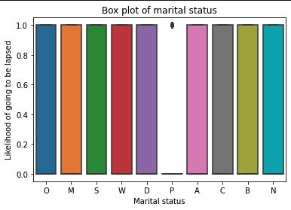
Features - Marital status
Majority classes are:
"Married"
"Domestic partner"
"Other"
"Widow"
"Single"

Slide 6
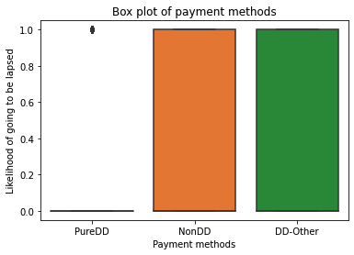
Features - Payment method
Average likelihood of going to be lapsed:
Payment method = Non-DD is 0.35
Payment method = Pure-DD = 0.2

Slide 7
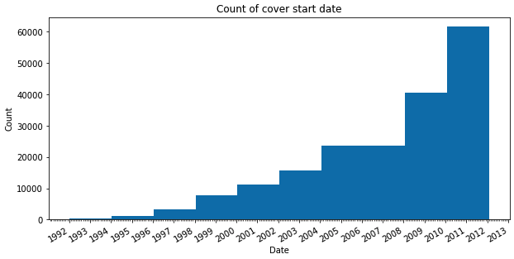
Features - Cover length

Slide 8
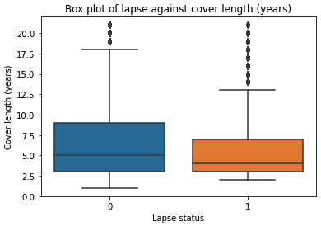
Features - Cover length
Cover length = 2013 - Cover started (year)
Lapsed group has shorter cover length
Average is 5 years and non-lapsed group is 6.38 years.

Slide 9
Modelling analysis
Logistic regression
Random undersampling + Boosting
XGBoost
Neural Network (1D-CNN)

Slide 10
XGBoost model
Advantages
1. A tree-based model to capture the complex relations of features
2. It is better at dealing with imbalanced data
3. A boosting algorithm that it is more robust to overfitting
4. It can produce the feature importance list
5. It works well with small dataset
6. There are many parameters to tune

Slide 11
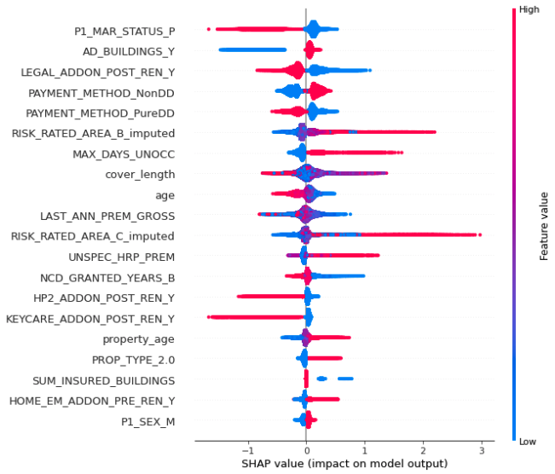
Shapley values for feature importance
Shapley value can evaluate each features’ contribution to the predictions
Having domestic partner
Building coverage
Legal fees option was purchased after 1st renewal

Slide 12
Evaluation of the model
Accuracy on the test set is 0.7013
F1 score on the test set is 0.5606
Confusion matrix:
Ground Truth\Predictions | Lapsed | Not lapsed
Lapsed | 208,907 | 11,972
Not lapsed | 4,936 | 10,787

Slide 13
Conclusion and Next steps
Trade off of precision and recall
Modification of the threshold
If more data were available such as mortgage information, education length (in years), past lapse data, price of policy, etc, it could improve the model performance

Slide 14
Thank you for listening

